Slide 1
Introduction to Phishing Attacks
Phishing is a form of social engineering and scam where attackers disguise themselves as trustworthy entities in order to gain sensitive information or installing malware.
This section provides an overview of how phishing works and the importance of recognizing and avoiding these threats.

Slide 2
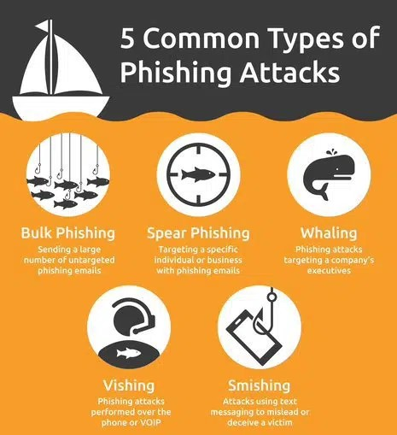
Understanding Phishing Tactics
Phishing attacks use deceiving tactics to trick victim into revealing sensitive information or performing harmful actions by acting as trustworthy source.
Cybercriminals may impersonate trusted organizations, create fake website or leverage social engineering to manipulate people.
Some common phishing methods include sending fraudulent emails , exploiting social media platforms and deploying malicious links.

Slide 3
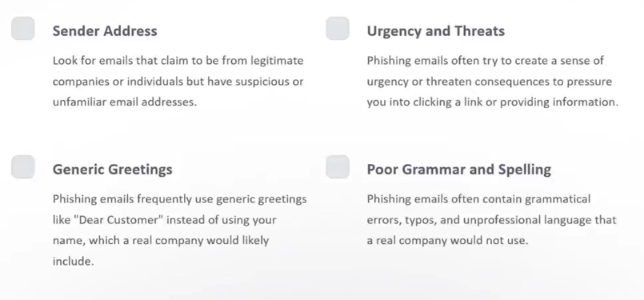
Recognizing Phishing Emails

Slide 4
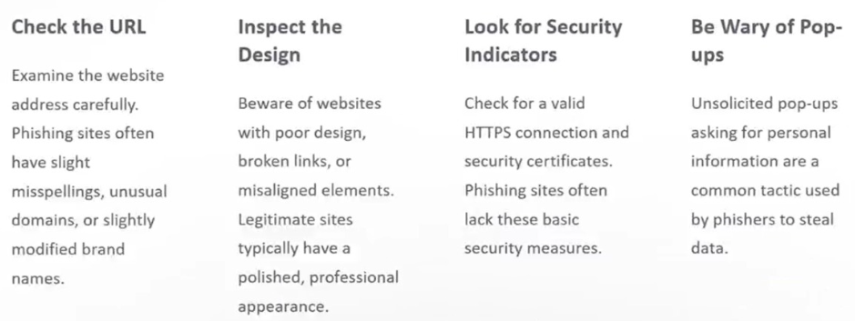
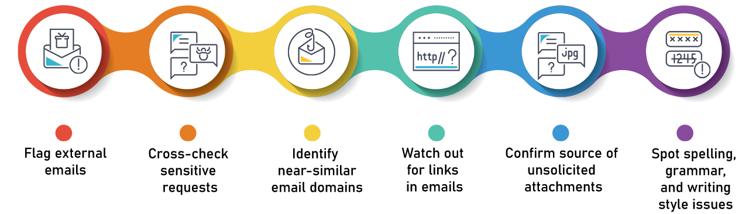
Identifying Suspicious Websites

Slide 5
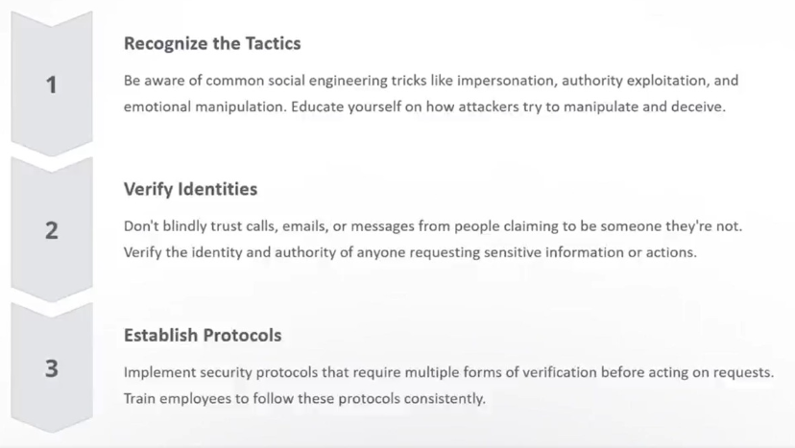
Protection Against Social Engineering

Slide 6
Reporting Phishing Attempts
Recognize : Identify suspicious emails, websites and messages.
Report : Contact your organization's security system.
Prevent : Help stop the spread of phishing attacks.
If you suspect a phishing attack was attempted, its important to report it right away.
Recognize the signs of a phishing attack - things like misspellings, urgent demands, or suspicious links. Then, immediately report the incident to your organization's security team or IT department. This will help them investigate the threat and take steps to prevent further attacks.

Slide 7
Educating Employees and Individuals
Effective phishing prevention requires comprehensive education programs to empower employees and individuals with the knowledge and skills to identify and avoid scams. Regular training sessions, simulated phishing exercises, and awareness campaigns can help create a culture of cybersecurity vigilance.
By equipping people with the ability to recognize suspicious email, social media, and website indicators, organizations can significantly reduce their vulnerability to phishing attacks. Fostering a proactive, security-minded mindset is crucial for protecting against the evolving tactics of cybercriminals.

Slide 8
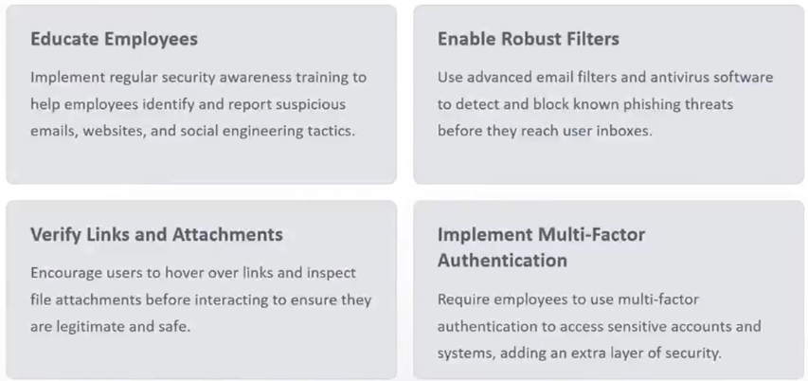
Best Practices for Phishing Prevention

Slide 9
Conclusion and Key Takeaways
In conclusion, understanding and defending against phishing attacks is critical in today's digital landscape. By staying vigilant, educating ourselves and others, and implementing best practices, we can significantly reduce the risk of falling victim to these insidious scams.

Slide 10
Thank you!

